Slide 1
World University Ranking INFO – 5709 Data visualization and communications
Tejesh Bathula
EUID : 11610736

Slide 2
Agenda
Introduction
Problem Statement
Motivation
Dataset
Visualizations
Techniques and Tools used
Future Work

Slide 3
Introduction
"Is the Ranking System Fair?” An assessment using the World University Rankings Dataset. World University Rankings are yearly rankings of universities worldwide based on a variety of indicators and criteria such as academic reputation, research output, quality of education, quality of faculty, scores of university and international diversity. This research provides an overview of the World University Ranking dataset.

Slide 4
Problem Statement
Choosing the good university plays major role in students career growth.
Here, I have some suggestions for the students to select the good university based on some of the criteria’s like quality of education, quality of faculty, alumni employment, Number of students in university.
Ranking the universities according to the above criteria’s mentioned is complex and challenging. But the ranking of the universities which made the management to focus on specific areas that are more easily measurable or rewarding institutions that have more resources are located in more developed regions.

Slide 5
Motivation
The world ranking of university dataset provides the quality of performance of the university worldwide.
This progress enables the decision making for the students, parents, researchers and policymakers.
This information enables institutions to compare themselves to their counterparts and suggest areas for development, adding to continuing efforts to improve the quality and accessibility of education globally.

Slide 6
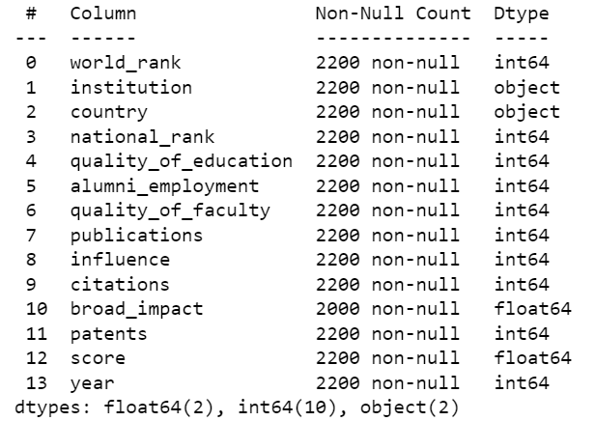
Dataset
For visualizing the world ranking of the universities we have the dataset “CwurData.csv” which is taken from Kaggle repository.
In the dataset we have 14 columns and 2200 records.
There are 2 float values, 10 int variables and
2 objective values in the data.
We have null values in the column broad _impact.

Slide 7
Dataset Variables
World_rank - world rank for university.
Institution - name of university.
Country - country of each university.
national_rank - rank of university within its country.
quality_of_education - rank for quality of education
alumni_employment - rank for alumni employment
quality_of_faculty - rank for quality of faculty
Publications - rank for publications.
Influence - rank for influence
Citations - number of students at the university

Slide 8
Approach
Uploaded dataset into power BI.
Performed data cleaning like replacing “null” values with “0”.
Filtered some of the data according to the variables “Scores”(filtered university score > 75%).
Performed various visualizations accordingly.

Slide 9
Question for Visualization
Show me the educational institutions from which parts of the world have been considered?
Show me the overview of your research?
Explain which countries have more universities and which countries have less universities?
Is there any relation between quality_of_education of the university and world_rank of the university?
Is there any relation between quality_of_faculty of the university and citations in the university?
Is there any relation between World_rank of the university and citations in the university?
Is there any relation between quality_of_education of the university and quality_of_faculty in the university?
Considering all the criteria of the universities show me the universities having their score greater than 75%?

Slide 10


Slide 11


Slide 12


Slide 13


Slide 14


Slide 15
Tools used
Python(To get information of the dataset).
Power BI(Filled null values and performed visualizations).
Microsoft created the business intelligence and data visualization technology known as Power BI. Users can share dashboards and reports with others, connect to a variety of data sources, and build interactive visualizations. Users can utilize Power BI to turn unprocessed information into useful insights and support them in making wise business decisions. It has a variety of features and instruments for data modeling, data processing, and data visualization, and is offered as both a desktop application and a cloud-based service. Power BI is extensively used by companies and businesses of all kinds, in a variety of industries, to interpret and analyze information, manage business KPIs, and keep an eye on critical performance indicators.

Slide 16
Future Work
Performing Time – Series analysis on the dataset. The dataset covers the university ranking from years between 2012 and 2015. Time series analysis technique will identify the patterns and trends in the ranking data and will predict the future ranking of the university.
Can also perform machine learning algorithms likes Linear Regression, Random Forest and Support vector machine. The linear regression algorithm will explain the linear relation between the predictor variables and target variable and will provide the importance of different features. Where as Random Forest model combines multiple decisions trees to increase the accuracy of the model.

Slide 17

Thank You

